Slide 1

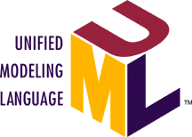

Metadata Integration using UML, MOF and XMI
Sridhar Iyengar : Unisys
June 10-16, 2000 : Oslo, Norway
OMG UML Tutorial Series
© 2000 OMG and Tutorial Contributors: EDS, IBM, Enea Data, IntelliCorp,
Klasse Objecten, ObjectTime Ltd., Rational Software, Unisys

Slide 2
OMG Trademarks Etc.
Object Management Group™
OMG™
UML®
XMI™
MOF™
CWM™
CORBA®
XML™
Homepage : www.omg.org

Slide 3

Tutorial Series
Introduction to UML
  November 1999, Cambridge, US
Behavioral Modeling with UML
  January 2000, Mesa, Arizona, US
Advanced Modeling with UML
  March 2000, Denver, US
Metadata Integration with UML, XMI and MOF
  June 2000, Oslo, Norway

Slide 4

Tutorial Series Goals
What you will learn:
  What the UML is and what is it not
  UML’s basic constructs, rules and diagram techniques
  How the UML can model large, complex systems
  How the UML can specify systems in an implementation-independent manner
  How UML, XMI and MOF can facilitate metadata integration
    Basic principles of Metamodeling
What you will not learn:
  Object Modeling
  Development Methods or Processes
  Metamodeling 202!

Slide 5

Integration using UML, MOF and XMI
Part 1: OMG Modeling and Metadata Architecture
    Sridhar Iyengar, Unisys Corporation
Part 2 : OMG Meta Object Facility (MOF)
    Sridhar Iyengar, Unisys Corporation
Part 3: OMG XML Metadata Interchange (XMI)
    Stephen Brodsky, IBM
Part 4: Wrap up and Futures
    Sridhar Iyengar and Stephen Brodsky
This is the last of the current 4 part series
  Slides posted on www.omg.org/uml

Slide 6

Architect’s Integration Dilemma
ArchiteXt (XML!)
DataMarts
SQL/Server
Designer
2000
Unisys
LINC,
UREP
Oracle Apps
Middleware (Tuxedo, JDBC, DCOM, IIOP, CCM, RMI, EJB, SOAP, COM+,…)
Information Models (MOF, UML, CWM, OIM, RSM, BODs, PIPs….)
Warehouse
NCR
Teradata
Siebel
IBM
VisualAge
Microsoft
Visual Basic
BEA
Weblogic
Distributed, Heterogeneous, Client/Server !
Multiple Clients, Servers, Tools, Apps, O/S, Databases, Repositories, Object Models

Slide 7
Software Architecture Evolution
Components
Frameworks
Business Objects
OO, O-R
Relational
Distributed Components
Object Models (UML)
XML Interchange(XMI)
Unisys, IBM, Oracle, MS..
C
O
M
P
L
E
X
I
T
Y
Y2000, Data
Warehouse
Data
Administration
Relational
Client/Server
E/R Models
CDIF Interchange
Platinum, ViaSoft, MSP..
Hierarchical,
Monolithic
E/R Models
Proprietary Interchange
IBM, Burroughs
1980 1990 2000
META MODEL EXTENSIBILITY

Slide 8
Solving the Integration Problem
What is needed?
Methodology for building, evolving and integrating software
A mechanism for cataloging and indexing and searching enterprise assets (metadata and data, internal and external)
A flexible service based distributed component architecture that spans the enterprise
A set of shared standard vocabularies (information models) and notation
A metadata driven approach to automate transformations between islands of information

Slide 9
Metadata Appears in many Environments
Application development tools and frameworks
  Models, Record definitions, Database definitions...
Component based environments
  Interfaces, Classes, Components, Deployment info, Models...
Data warehouses and enterprise information portals
  Tables, Columns, Schemas, Cubes, Dimensions...
Systems management environments
  MIBs, Performance statistics, Configuration info...
Middleware
  Formats, Protocols, Configuration information etc

Slide 10
OMG A&D PTF Premise
The use of Modeling and Metadata enabled architectures allows us to manage the complexity of software development, application integration and data warehouse management
Modeling and Metadata standards are necessary for interchange of software artifacts and interoperability between tools, applications, middleware and data stores

Slide 11
Metadata Basics
Meta data is “data about the data”, “model about models”, “definitions of computing and business assets”-- and more
  Technical : Design and Middleware meta data
  Administrative and process meta data
  Business meta data
End users, Software designers and IT personnel need to know:
  What does the data mean? What is its structure and format?
  Where did it come from? How was it calculated?
  When was it loaded? Who owns it? Where is it used?
  Etc.
Most metadata undocumented and usually locked up causing serious interchange and interoperability problems

Slide 12
There is more & more metadata lurking around!
REPOSITORY
Person Table
User::John Doe
Person Table Space
Employee
Record
Name Char
Marital Status Enumeration (M, D, W, S)
Age Integer
Meta Data
Created-by
John M 43
Mary D 27
Bill W 62
George S 18
Meta Data
Data
Archive
Last good Archive
9/28/1998 : 2 AM
LastName String
First Initial String
Employee Number Number
Meta Data

Slide 13
Why (Meta)Model?
Understand and describe the problem domain
Help others understand the problem domain by using the same language
Define a vocabulary for the elements in the problem domain
Manage complexity by raising the level of abstraction at which we think and design
Civil, Mechanical and hardware engineers have been adept at this for much longer than us
Metamodels are used in the domain of modeling middleware and type systems (UML, IDL, CWM…)

Slide 14
Why Metadata enabled Systems?
Manage complexity of systems and applications
Dynamic development tools and applications need component and legacy meta data (MOF, XML)
  Component assembly, work flow driven applications, wrappers
Data warehouse environments are becoming more dynamic and mission critical!
  The days of weekly and daily batch updates are being replaced by more frequent synchronization
Distributed systems evolve independently
  Need meta data for logical centralization and for reconciling discrepancies as systems evolve
Lower cost of integration and evolution

Slide 15
Metamodeling : Basics
The “meta” prefix
  indicates one level of abstraction higher than root
  is used in a relative manner
A metamodel is a model of a model
The concept can be recursively applied to itself
  a meta-metamodel is a model of a metamodel
  a meta-meta-metamodel is a model of a meta-metamodel … and so on
Typically 4 layers (M0-M3) are considered adequate
Tools now assist ‘Visual metamodeling’
OMG is now using M0-M3 notation for modeling
Metamodels are usually defined for specific technology domains

Slide 16
OMG - Modeling and Metadata Standards
OA&D, Metadata Repository RFI 1994-1995
Object Analysis & Design Facility : Unified Modeling Language (UML) 1997
Distributed Metadata Management : Meta Object Facility (MOF) 1997
Stream based Model Interchange Format : XML Metadata Interchange (XMI) 1999
CORBA Component Model, IDL Metamodel : 1999
Data Warehouse Management : Common Warehouse Metamodel (CWM) 2000
UML profile for CORBA 2000
Business Objects : Business Object Initiative (BOI*) 2000-2001, Domain metamodels 2000-2001 etc.
*In development

Slide 17
OMG Metamodel Architecture
Defined By
OMG Terms
Sample Objects
XML/Java Terms
A
P
P
L
I
C
A
T
I
O
N
User Objects
Layer (M0)
<Acme_Software_Share
User Objects
XML Docs/Java Objects
Business data
98789>, 654.56, sell_limit_
order, <Stock_Quote_Svr
32123>
StockShare, askPrice,
Model
Layer(M1)
sellLimitOrder,
Business Models, DTDs, Java Classes
App Schemas
StockQuoteServer
[Models, Interfaces, BODs]
M
I
D
D
L
E
W
A
R
E
Metamodel
Layer(M2)
UML::Class,Attribute,
CWM, EAI, IDL, UML, DTD/Schema
Middleware Schema
CWM::Table, CWM::Cube
[UML, CWM, EAI, IDL…]
Meta-Metamodel
MOF::Class, MOF::
Attribute, MOF::Operation
[MOF]
MOF DTD/Schema
Schema of Schema!!
Layer (M3)

Slide 18
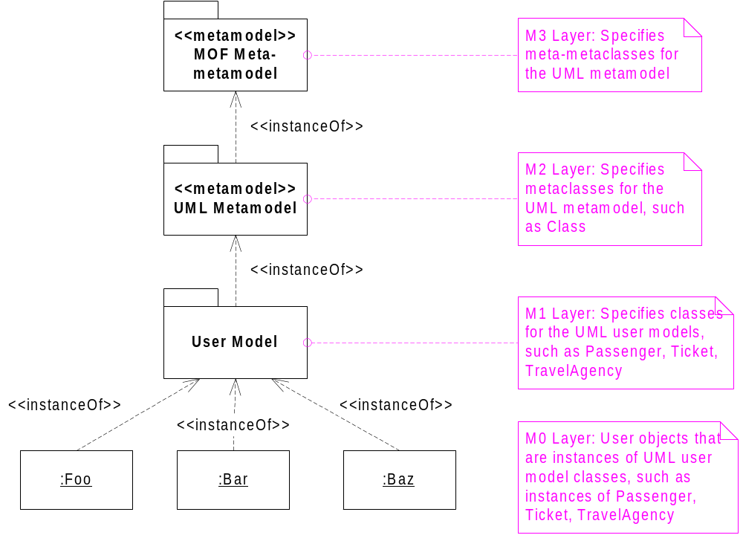
OMG Metamodel Architecture

Slide 19
OMG MetaModel Architecture (runtime)
Tools, Applications, Repositories, Registries
MetaModels (UML, CCM, CWM…)
XML Metadata Interchange (XMI)
Meta Object Facility (MOF)
Object Services
Internet
CORBA
CORBA/COM Interworking
Java

Slide 20
OMG OMA & Metadata Architecture
Repositories
Tools
Applications
Modeling and Metadata Facility
MOF
XMI
UML, CWM
APIs
APIs
Information
MetaModels
Object Request Broker
Object Services (Naming, Transactions…)
Iyengar (c) 1995, Unisys

Slide 21
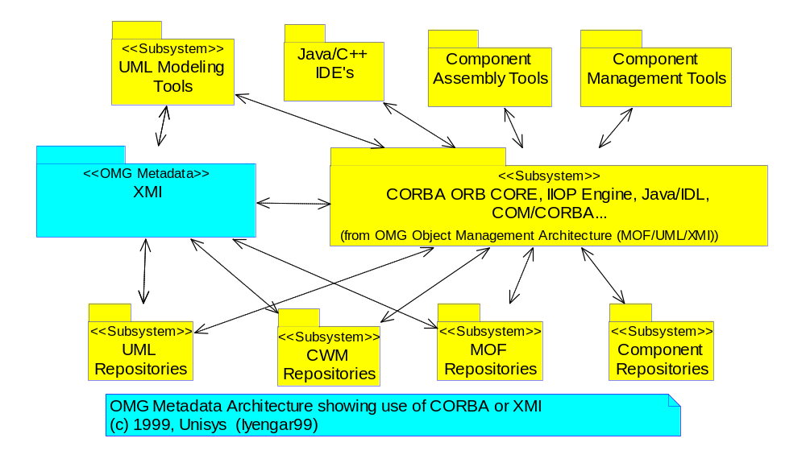
Modeling and Metadata Environment
XML
IDL
XML
IDL

Slide 22
OMG Modeling and Metadata Framework
UML
Model & Design
XMI
MOF2XML DTD
MOF2XML Doc
MOF2XML Schema*
Vertical Industry
Specifications
Framework
Data Warehousing
MOF
Meta Manage
B2B Application
Integration
Model Driven
App Development
IDL
MOF2IDL
JMI*
MOF2Java
MetaData
Management
And So On
* Coming
JSR-40 JMI : Java Metadata Interface

Slide 23
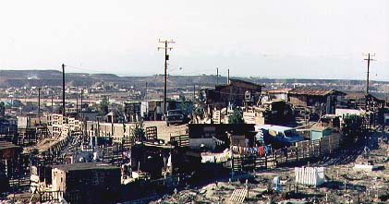

Software mess to Architected Elegance
Tijuana “shantytown”: http://www.macalester.edu/~jschatz/residential.html
OMG Modeling & Metadata
UML
Model & Design
XMI
MOF2XML DTD
MOF2XML Doc
MOF2XML Schema*
Vertical Industry
Specifications
Framework
Data Warehousing
MOF
Meta Manage
B2B Application
Integration
Model Driven
App Development
IDL
MOF2IDL
JMI*
MOF2Java
MetaData
Management
And So On
Fallingwater:
http://www.adelaide.net.au/~jpolias/FLW/Images/FallingWater.jpeg

Slide 24
OMG E-Business Integration Vision
The Big Picture of how it all ties together
Community & Enterprise Information Portals (KM…)
HealthCare
Financial
Manufacturing
Insurance...
E-Business
Application
Development
UML, CCM
E-Business
Application
Integration
CCM, EJB,
UML4EAI
E-Business
Intelligence
CWM
Information Models, Components
and Metadata (MOF, XMI…)
Directory, Security, Database,
Web, Transaction, Caching,
Metadata, Services..
Distributed Runtime Middleware (IIOP, XML/Value, HTTP…)
(C) Iyengar 2000

Slide 25
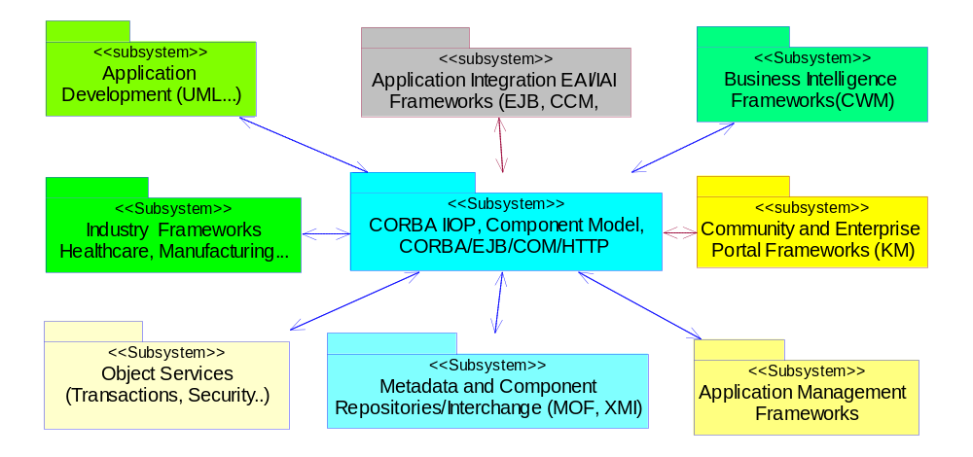
UML representation of the emerging
OMG E-Business integration vision

Slide 26
Importance of MOF, XMI and UML
Model driven approach to software design
Metadata driven approach to defining and managing software artifacts
Metamodels and middleware work together to enable integration of systems
Even middleware can be modeled
A unifying middleware neutral modeling and metadata framework
Brings together the best of OMG, W3C, Java and Microsoft Technologies
‘A new architectural synthesis’ Paul Harmon, Cutter Information Group

Slide 27
Importance of MOF, XMI and UML
Understand, analyze and design software using UML
Design and integrate tools, middleware and applications in a flexible manner using MOF
  Across previous islands of information
Interchange metadata and objects using XML across platforms in a loosely coupled manner (XMI)
Interchange metadata and objects using IDL across platforms across languages (MOF2IDL, JMI…)
A unifying model driven architecture

Slide 28
UML Quick Tour
The UML is a graphical language for
  specifying
  visualizing
  constructing
  documenting
the artifacts of software systems
Added to the list of OMG adopted technologies in November 1997 as UML 1.1
Most recent minor revision is UML 1.3 (November 1999)
Covered in detail already

Slide 29
OMG UML 1.3 Specification
UML Summary
UML Semantics
UML Notation Guide
UML Standard Profiles
  Software Development Processes
  Business Modeling
UML CORBAfacility Interface Definition (IDL)
UML XML Metadata Interchange DTD, Document
Object Constraint Language

Slide 30
MOF Quick Tour
Meta Object Facility (MOF) is a model driven distributed object framework for
  Specifying
  Constructing
  Managing
  Interchanging and
  Integrating
metadata in software systems, thus enabling the flexible integration of systems

Slide 31
MOF : The Motivation
Lots of proprietary metadata sources
Need to manage IT assets (components, documentation, schemas…)
New metamodels are proliferating
  OMG, W3C and MDC standards (among others)
  Customized development methods
  XML Models (DTDs, Schemas...)
  Products addressing both new and existing areas
Need to bridge the gap
  Common language across metamodels
  Interoperability and federation of tools, data sources
  Ease metamodel, tool and middleware development

Slide 32
MOF 1.3 History
MOF work rooted in OMG Repository RFI in 1995
MOF 1.1 was adopted along with UML in November 1997 as an OMG standard.
MOF 1.3 a minor revision was adopted in November 1999 along with UML 1.3
Key contributors to the MOF 1.1 include
  Unisys, DSTC, IBM, Oracle, ICL, Objectivity, SSA, CA/Platinum (submitters)
  EDS, Rational … (Supporters)
MOF RTF continues refining the spec
  mof-rtf@omg.org ; www.dstc.edu.au/mof is RTF home page

Slide 33
OMG MOF 1.1/1.3 Specification
MOF Semantics : OMG Meta-meta model (M3)
MOF Reflective Interfaces for generic manipulation of metadata {using CORBA IDL}
MOF to IDL mappings for type safe manipulation of metamodel specific information
MOF facility for finding and managing federated repositories
MOF to XML Mapping : OMG XMI Spec
  XML DTD, XML Documents, XML Schema (initial submission)
MOF to Java Mapping : SUN JSR-40, JMI Spec
Covered in detail in Part 2 of this tutorial

Slide 34
XMI Quick Tour
XML Metadata Interchange (XMI) is a model driven distributed XML framework for
  representing,
  Interchanging and
  Integrating
metadata and objects in software systems, thus enabling the flexible integration of systems
XMI is a mapping of MOF to W3C XML

Slide 35
OMG XMI 1.1 History
UML 1.1 and MOF 1.1 specified interchange using CORBA IDL
  Not very practical for transmitting large amounts of fine grained data between systems
OMG issued Stream based Model Interchange Format RFP in December 1997
Key contributors to XMI include
  Unisys, IBM, DSTC, Oracle, CA/Platinum, Fujitsu, Softeam, Reccerca, Daimler-Benz (submitters)
  20+ OMG members including EDS, NCR, Rational, Inline, Nihon Unisys…. (supporters)

Slide 36
OMG XMI 1.0/1.1 Specification
Mapping of MOF compliant metamodels to XML DTDs
  DTD provide standard representation of metamodel
  XML document that conforms to MOF DTD is a preferred representation of metamodel
    Use XML document itself to represent metamodel
Mapping of MOF compliant models to XML documents (streams)
  Transmit and interchange instance data that conforms to the metamodel
  Mapping to XML Schema is in progress
XMI Covered in detail in Part 3 of this tutorial
A new proposal XMI for XML Schema is now being standardized

Slide 37
Integration using UML, MOF and XMI
Part 1: OMG Modeling and Metadata Architecture
    Sridhar Iyengar, Unisys Corporation
Part 2 : OMG Meta Object Facility (MOF)
    Sridhar Iyengar, Unisys Corporation
Part 3: OMG XML Metadata Interchange (XMI)
    Stephen Brodsky, IBM
Part 4: Wrap up and Futures
    Sridhar Iyengar and Stephen Brodsky
This is the last of the current 4 part series
  Slides posted on www.omg.org/uml

Slide 38
MOF Drill Down
Definitions and Concepts : Quick tour
MOF Architecture
MOF Model
MOF Reflective Interfaces
MOF to IDL Mappings
MOF Facility
MOF based metamodels and applications
  UML, CWM, IDL, CCM etc
  Use of Reflective VS Tailored Interfaces

Slide 39
MOF Quick Tour
Meta Object Facility (MOF) is a model driven distributed framework for
  Specifying
  Constructing
  Managing
  Interchanging and
  Integrating
metadata in software systems, thus enabling the flexible integration of systems

Slide 40
MOF : Specifying Metadata
The MOF Model (OMG Meta-metamodel) is used to precisely specify technology and domain specific metamodels and object definitions
The design specification uses OMG UML notation
  Stereotypes and Tagged Values are used to capture additional MOF metadata needed for IDL and XML generation (e.g.: resolve name conflicts for bindings)
MOF supports a subset of the UML Class modeling concepts
  Association Classes and N-Ary Associations need to be modeled as Classes
  Makes MOF lightweight and optimized for metadata

Slide 41
MOF : Constructing and Managing
Constructing Metadata Systems
  The MOF is first used to define a specific metamodel (such as UML or CWM)
  The MOF to IDL mapping allows automatic generation of CORBA IDL interfaces from the metamodel definition
  MOF based CORBA, Java or COM Servers can also be generated to enable more rapid tool construction
Managing Metadata Systems
  MOF based metadata (such as UML designs, CWM Database schemas and transformations) can be programmatically manipulated locally or across a network
  This metadata can be used to manage and tune systems

Slide 42
MOF : Interchanging Metadata
Systems that conform to the MOF can interchange metadata using CORBA from a variety of programming languages (Java, C++, C…) and middleware systems (COM, DCE…)
  Typically used for application integration scenarios
Using XMI (mapping of MOF to XML), MOF based metadata can be exchanged using XML
  Application development, data warehousing, document management, application integration...
Using JMI : Java Metadata Interface currently under development using the SUN Java Community Process, Java based metadata can be interchanged

Slide 43
MOF : Integrating Metadata
Most systems have proprietary metadata used to construct, manage of optimize the system
This metadata can be modeled using MOF for each legacy or new system
Using MOF and CORBA or MOF and XML, these different sources of metadata can be combined or subsetted to create federated views of the overall system
  Example : Various parts of application development life cycle or data warehousing life cycle have different but related metadata
You integrate a system by integrating its metadata

Slide 44
MOF : Model driven distributed framework
Model driven
  UML is used for design of metamodels
  MOF model (a subset of UML) is used for implementing metamodels
Distributed
  MOF uses CORBA for federation and distribution
  Different MOF based metadata sources and servers can be accessed across the network
  All distributed CORBA services can be leveraged
Framework
  The MOF::Reflective interfaces can be used across meta levels
  The MOF to IDL, XML and Java mappings allow consistent manipulation of all compliant metadata based on well defined design patterns
  The framework is extensible using standard OO techniques

Slide 45
MOF Drill Down
Definitions and Concepts : Quick tour
MOF Architecture
MOF Model
MOF to IDL Mappings
MOF Reflective Interfaces
MOF Facility
MOF based metamodels and applications
  UML, CWM, IDL, CCM etc
  Use of Reflective VS Tailored Interfaces

Slide 46

MOF Overview
Foundation for OMG metadata and modeling architecture
  Model, design and implement metamodels
    Use UML notation
  Provides 4 generic meta-object interfaces for introspection (Used by all MOF based Meta-models...)
  Provides MOF-IDL mapping to automate generation of concrete object interfaces for specific metamodels
    Can be used with C++, Java, COM… using appropriate language bindings/gateways
  Provides MOF-XML mappings to automate generation of XML DTDs and Documents (XMI specification)
  Provides MOF-Java mapping as part of SUN Java Community Process JSR-40 (In progress)

Slide 47


MOF Architecture
Four layered metamodel architecture
  Integrated with CORBA, UML, XML and Java
Packages/CORBA Modules
  Model : The meta-metamodel
  Reflective : generic metadata interfaces
  Facility : Repository/Model management
Aligned with the OMG UML Core
  Uses UML Class Diagram notation for metamodel schemas

Slide 48
OMG Metamodel Architecture
MOF is at the root of the OMG 4 layered Metamodel Architecture

Slide 49
MOF Package Architecture
Discover & Manipulate
metadata
<<CORBA IDL Module>>
MOF 1.3 Reflective
Model using UML Class Diagrams precisely
<<OMG Meta-metamodel>>
MOF Model
Find and Manage
Metadata Repositories, Servers
MOF Facility

Slide 50
The MOF Model (OMG M3)
Relatively small but not minimal to facilitate UML alignment
Rich enough for variety of metamodels
  Proven in application development (UML), distributed middleware (IDL, CCM, EJB), data warehouse (CWM)
Inbuilt and model-specific constraints
Supports discovery, extensibility, sharing
CORBA-based and distributable
An interface not an implementation (could be mapped to a relational catalog, memory, XML…)

Slide 51
OMG MOF Model : Key Classes
Contains
ModelElement
+constrainedElement
0..1
0..1
1..*
0..*
1..*
0..*
Constrains
+container
0..*
{ordered}
0..*
+containedElement
Namespace
Feature
Constraint
+subtype
Generalizes
0..*
0..*
GeneralizableElement
BehavioralFeature
StructuralFeature
+supertype
0..*
{ordered}
0..*
Package
Classifier
Operation
Reference
MofAttribute
0..*
+referent
0..*
RefersTo
DataType
Class
Association
+referencedEnd
1
1
AssociationEnd

Slide 52
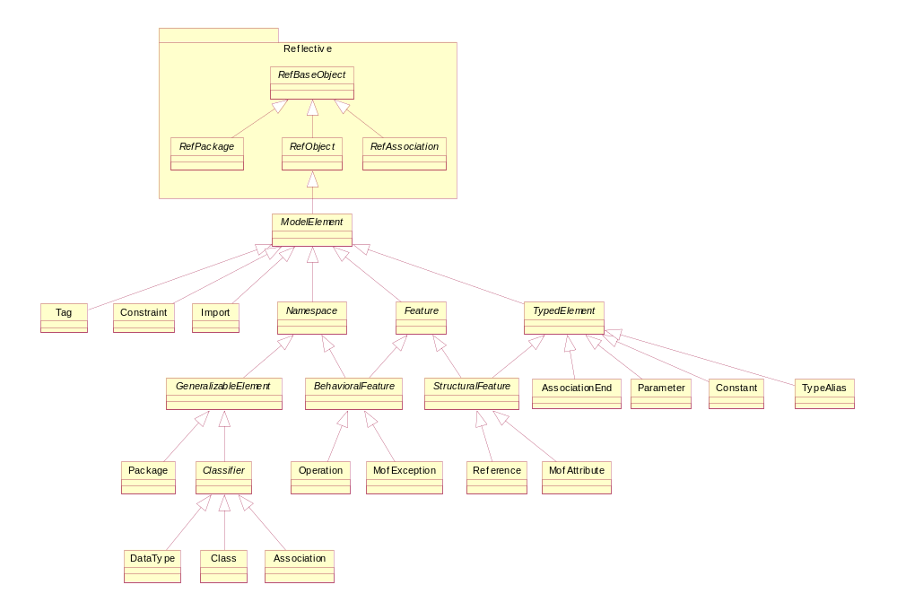
MOF Inheritance Hierarchy

Slide 53
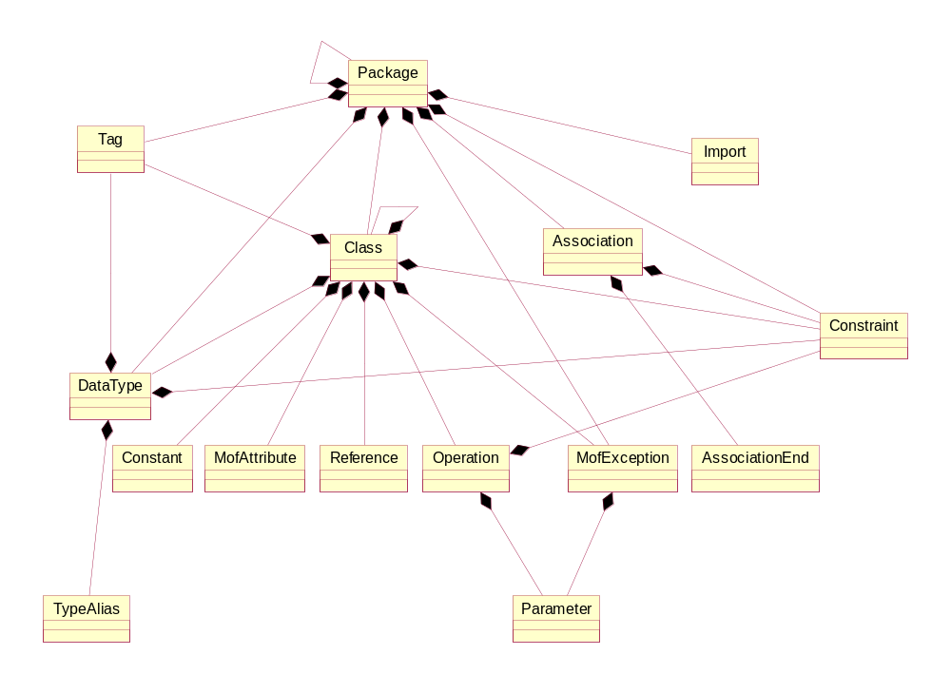
MOF Containment Hierarchy

Slide 54
MOF Model vs. UML Core
MOF does not need a full blown object: Generalization, Dependency
Associations are simpler: binary only, not objects in own right (no AssociationClass), mapped to References on classes, no N-ary associations
  These constraints are well formedness rules.
Simpler types/options e.g. Multiplicity
More constrained - less freedom, more completeness needed
Assumption of federation (e.g. a class does not know its subclasses)

Slide 55
MOF Model Interfaces
Core
Supporting
Package (Model)
Class
DataType
Attribute
Operation
Reference
Association
AssociationEnd
Constraint
Exception
ModelElement
Namespace (Container)
Classifier
BehavioralFeature
StructuralFeature
Parameter
Tag
Various Associations

Slide 56
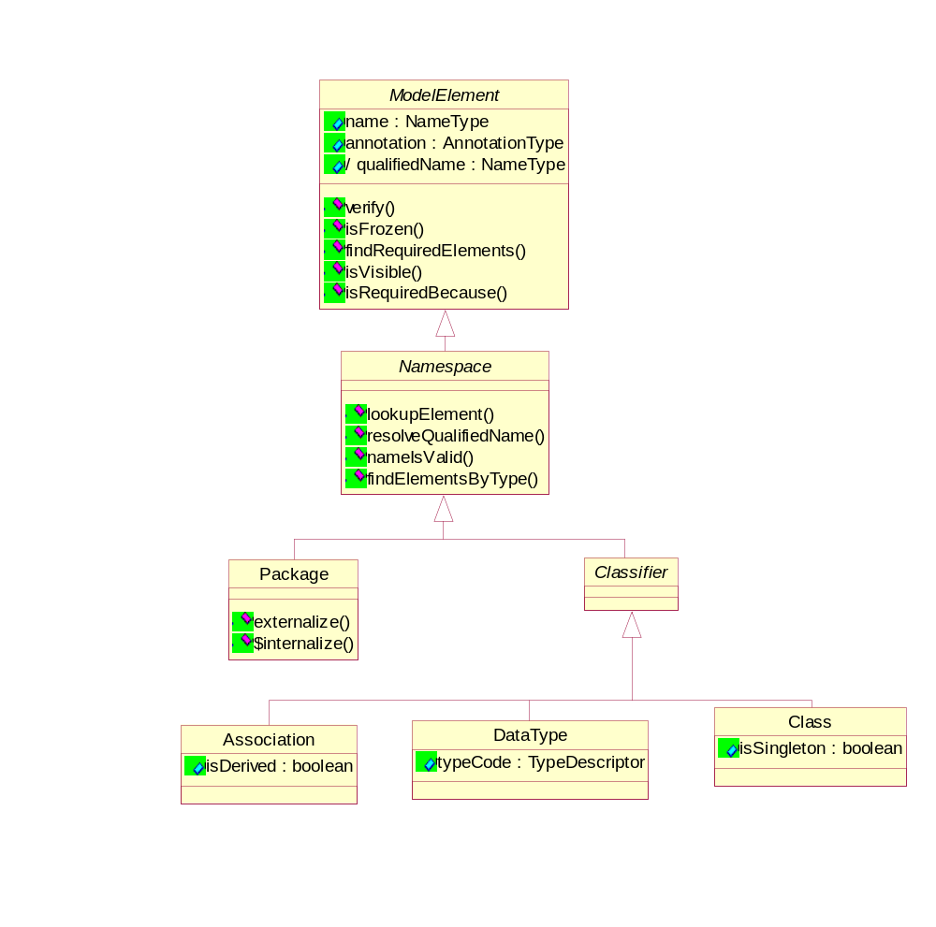
MOF Details : Classifiers

Slide 57
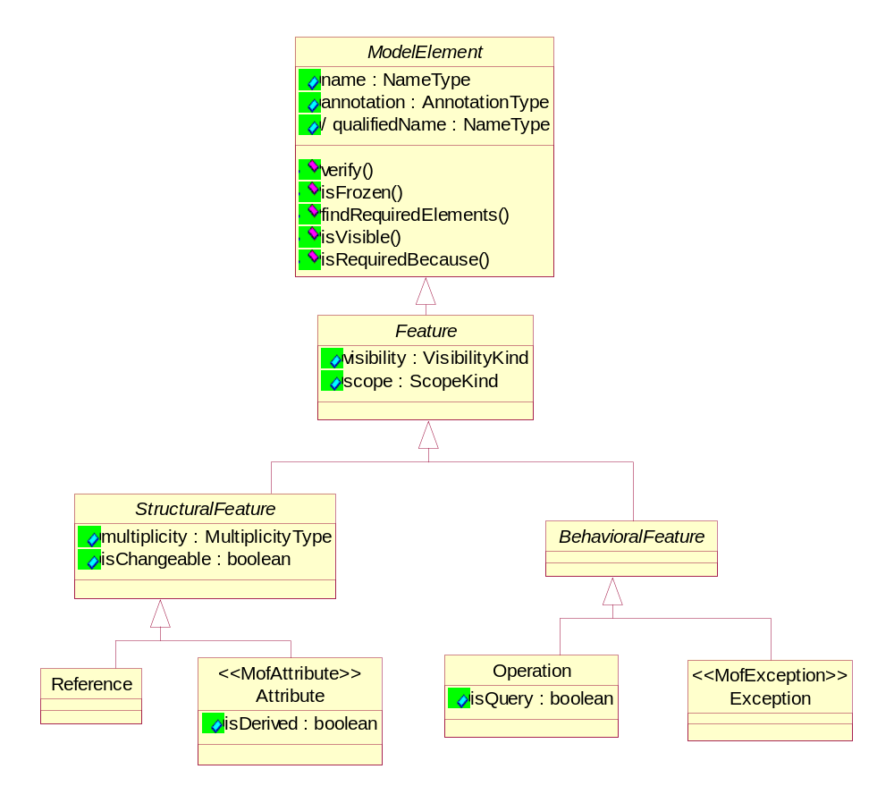
MOF Details : Features

Slide 58
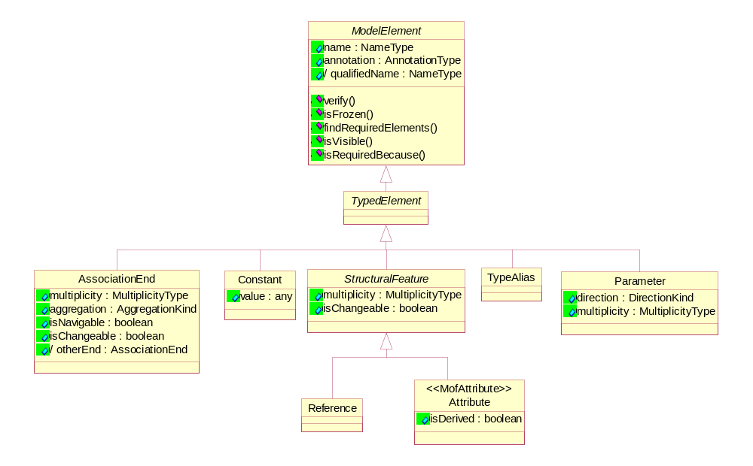
MOF Detail : TypedElements

Slide 59
MOF Drill Down
Definitions and Concepts : Quick tour
MOF Architecture
MOF Model
MOF to IDL Mappings
MOF Reflective Interfaces
MOF Facility
MOF based metamodels and applications
  UML, CWM, IDL, CCM etc
  Use of Reflective VS Tailored Interfaces

Slide 60
MOF-IDL Mapping & Generation
MOF spec includes a MOF-IDL mapping spec that can be used to automate IDL generation for metamodels
  This mechanism was used to generate the IDL for both MOF and UML
  This mechanism can be used to generate CORBA metamodel servers
  A similar mapping from UML to IDL is necessary (UML Profile for CORBA addresses this partially)
Users can choose generic (reflective) MOF interfaces or specific (concrete) interfaces for manipulating the UML metamodel

Slide 61
MOF - IDL Mapping
Templates provided for each MOF construct
  Package, Class, Attribute, Association, Reference, Operation etc.
  For example each MOF Class is mapped to two interfaces
    Factory interface which has constructor and finder methods
    Object interface which has the methods on individual objects
  Another example : each MOF Attribute is mapped to two accessor and mutator methods
Conformance to MOF implies that these interfaces are implemented
  Auto generation not required by spec but usually implemented

Slide 62
Reflective vs. Generated Interface
Generated
  AttributeClass::create_Attribute(…constructor args…)
  Attribute::set_InitialValue(string)
  string Attribute::initialValue()
Reflective
  refObject::createInstance(…constructor args…)
  refObject::setValue(DesignatorType, ValueType)
  refObject:: value(DesignatorType)
Feature Designator found by discovery or look-up by name
More coding involved
But allows working with models unknown when tool built
Opens way for new class of generic tools

Slide 63
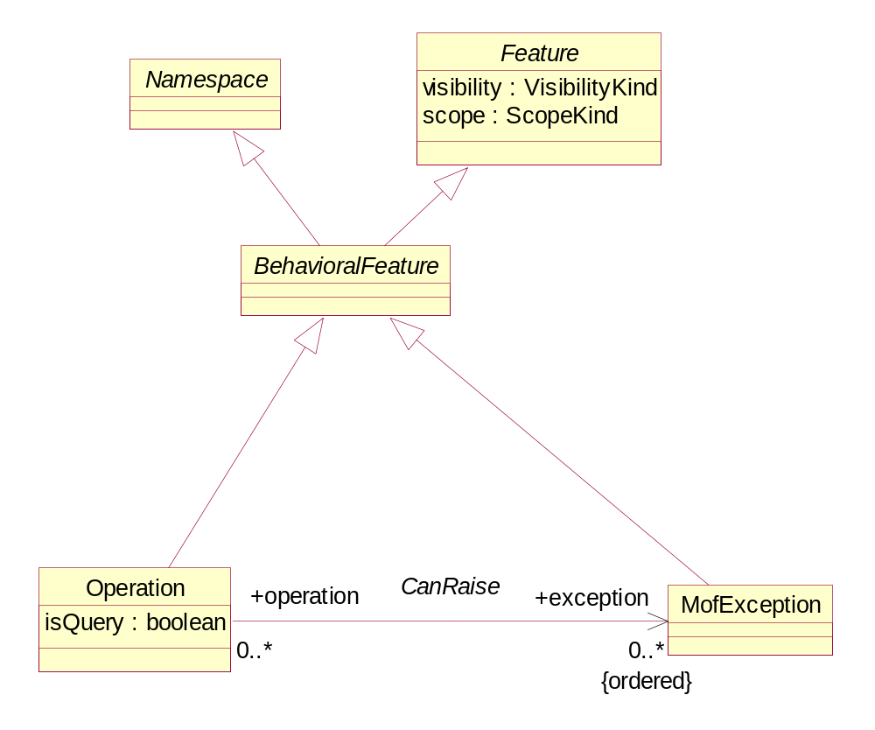
BehavioralFeature : MOF - IDL

Slide 64
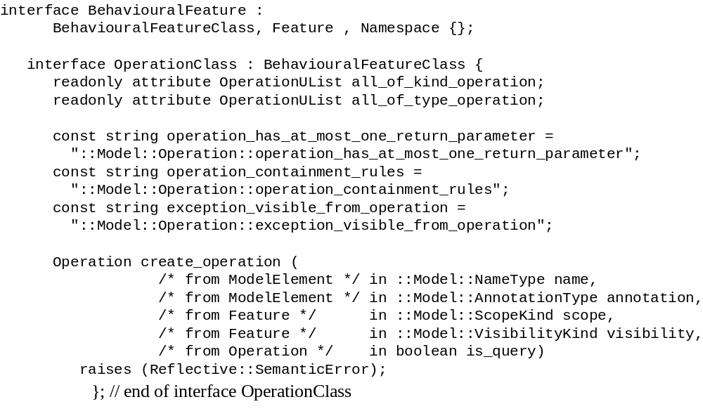
Interface OperationClass

Slide 65
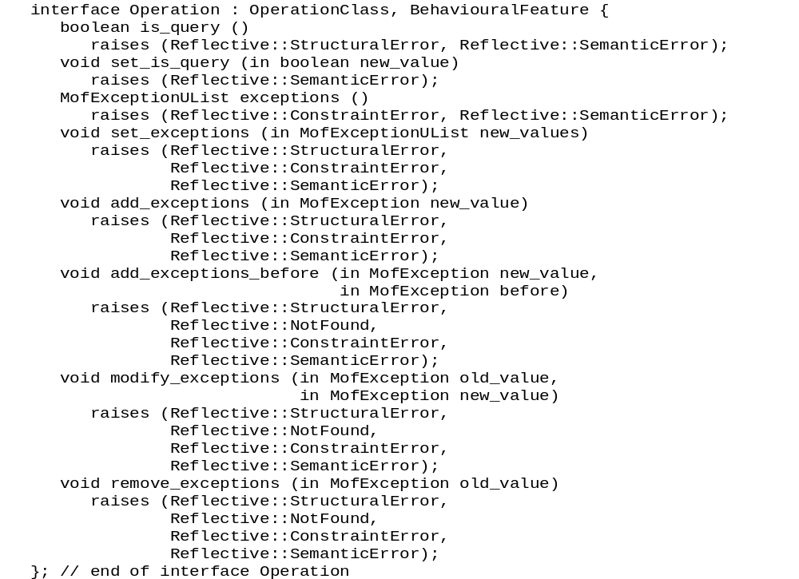
Interface Operation

Slide 66
MOF Reflective Interfaces
RefBaseObject
RefPackage
RefObject (Class)
RefAssociation
Used for general purpose (metamodel independent) metaobject manipulation
Used for interoperability across metamodels

Slide 67
MOF 1.3 Reflective Package
<<Interface>>
All meta-models based on the MOF inherit this package.
Can be used to manipulate
any MOF based metadata
RefBaseObject
refMofId()
refMetaObject()
refItself()
refImmediatePackage()
refOutermostPackage()
refDelete()
<<Interface>>
RefObject
<<Interface>>
refIsInstanceOf()
<<Interface>>
RefPackage
refCreateInstance()
RefAssociation
refClassRef()
refAllObjects()
refAllLinks()
refAssociationRef()
refValue()
refLinkExists()
refPackageRef()
refSetValue()
refQuery()
refUnsetValue()
refAddLink()
refAddValue()
refAddLinkBefore()
addValueBefore()
refModifyLink()
refAddValueAt()
refRemovLink()
refModifyValue()
refModifyValueAt()
refRemoveValue()
refRemoveValueAt()
refImmediateComposite()
refOutermostComposite()
refInvokeOperation()

Slide 68
Reflective vs. Generated Interface
Generated
  AttributeClass::create_Attribute(…constructor args…)
  Attribute::set_InitialValue(string)
  string Attribute::initialValue()
Reflective
  refObject::createInstance(…constructor args…)
  refObject::setValue(DesignatorType, ValueType)
  refObject:: value(DesignatorType)
Feature Designator found by discovery or look-up by name
More coding involved
But allows working with models unknown when tool built
Opens way for new class of generic tools

Slide 69
Metamodeling using MOF & UML
Understand the metamodeling (representation of models) domain
  Object modeling (UML), Business Objects (UML For Business Objects...), Database Management, Data warehousing etc.
  Define initial metamodel reusing concepts from existing metamodels when possible
  Use UML core modeling constructs available
Use UML based visual modeling tools
  These can be customized for the MOF using UML/MOF extension mechanisms

Slide 70
Metamodeling using MOF & UML
Use UML for analysis and design of metamodels (these are models after all!)
Define metamodels using the MOF
  Use UML based modeling tools, or MOF interfaces (normative) or XMI
  Enables life cycle metadata interoperability and design reuse across metamodels
  Relationships and subtyping across metamodels supported by the MOF
Use MOF-IDL mappings for concrete IDL interfaces to metamodels
Inherit MOF Reflective interfaces for interoperable metaobjects across metamodels
Use XMI for exchanging metadata

Slide 71
Practical scenarios of MOF Usage
Exchange of object models between development tools using UML
Metadata foundation for development of business object applications (refinement and relationships across metamodels)
Use of object repositories for integrating development tools, data warehouse tools and business object tools
Interoperable metadata registries/repositories
Exchange metadata over the Web using IIOP, HTTP, MOF and XMI

Slide 72
XMI/MOF for E-Business Application Development OMG November 98 Demo
Community & Enterprise Information Portals (KM…)
Web
Sphere
Rose
VA
TC
DTD
Gen
VA
Java
HealthCare
Financial
Manufacturing
Insurance...
E-Business
Application
Development
UML, CCM
E-Business
Intelligence
CWM, OIM
E-Business
Application
Integration
CCM, EJB,
COM+,XML
XMI
IBM
VisualAge
Information Models, Components
and Metadata (XMI, MOF…)
Directory, Security, Database,
Web, Transaction, Caching,
Metadata, Services..
XMI
Distributed Runtime Middleware (IIOP, HTTP…)
Oracle
Repository
Select
MOF/XMI
XMI
XMI
XMI
Enterprise
Unisys
UREP
Oracle
Designer
XMI
XMI
XMI
XMI
XMI
Non-XMI
Repositories
Rational
Rose
Select
Enterprise
MOF
DTDGen

Slide 73
Common Warehouse Metamodel (CWM)
Scope
  Data Warehouse lifecycle metadata management
Contributors : IBM, Unisys, NCR, Hyperion, Oracle, Genesis, UBS, Dimension EDI...
  Metamodel - Single logical & physical!
  Generated XML DTDs
  Generated MOF - IDL mappings
  Generated XML document
Adopted by OMG in June 2000 (Oslo)
CWM Interoperability showcase in Sep 2000

Slide 74
CWM 1.0 Overview {02/2000}
Common Warehouse Metamodel
Warehouse
Management
Warehouse
Process
Warehouse
Operation
Analysis
Transformation
OLAP
Data
Mining
Information
Visualization
Business
Nomenclature
Object-
Oriented
(UML)
Relational
Record-
Oriented
Multi
Dimensional
XML
Resources
Business
Information
Data
Types
Expressions
Keys
Index
Type
Mapping
Software
Deployment
Foundation
UML 1.3
(Foundation, Behavioral_Elements, Model_Management)

Slide 75
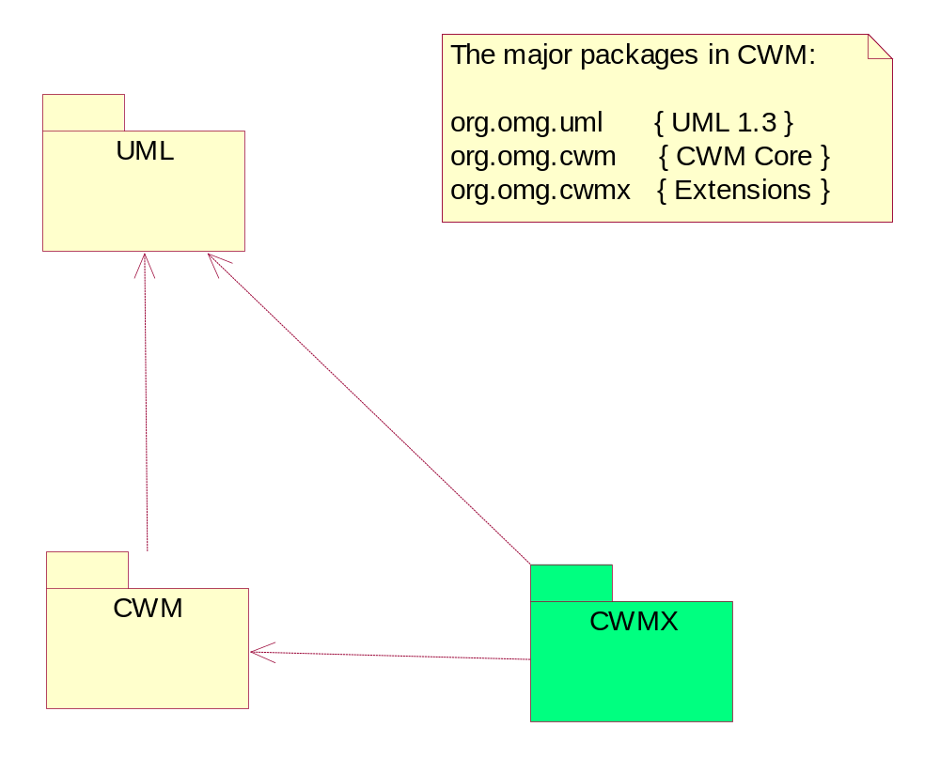
CWM 1.0 Model - Top Level

Slide 76
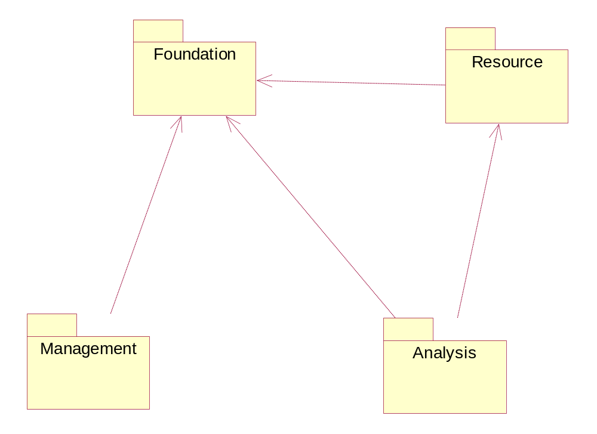
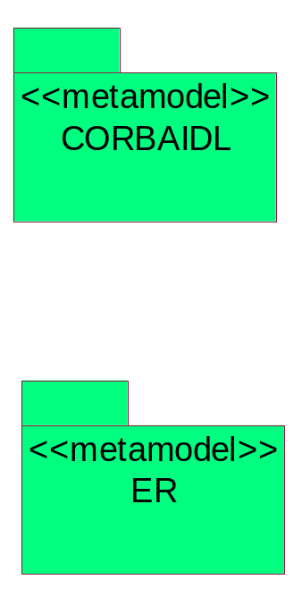
CWM 1.0 - Overview

Slide 77
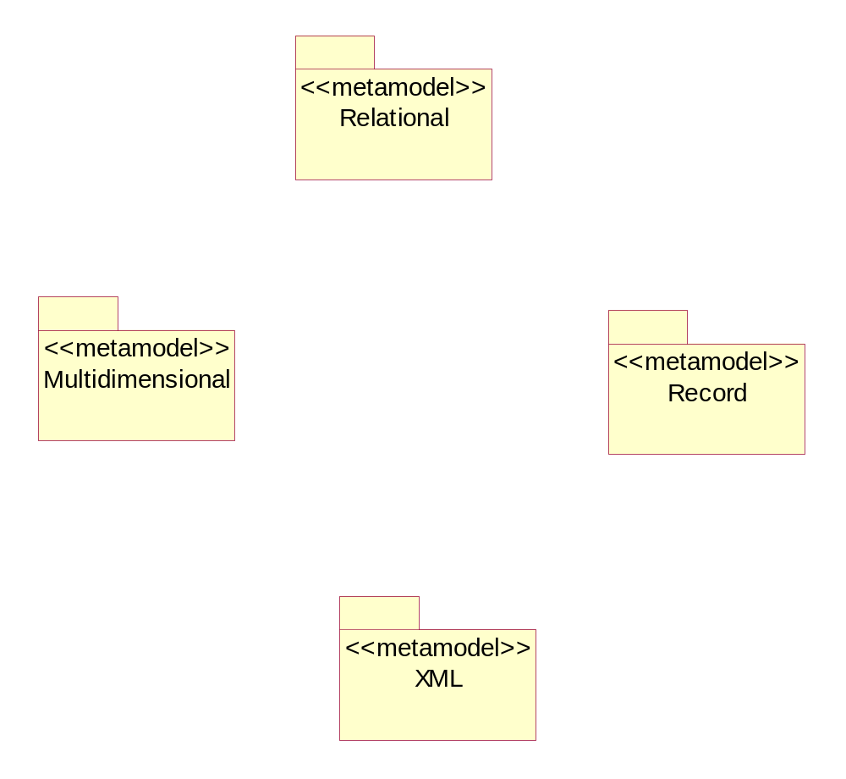
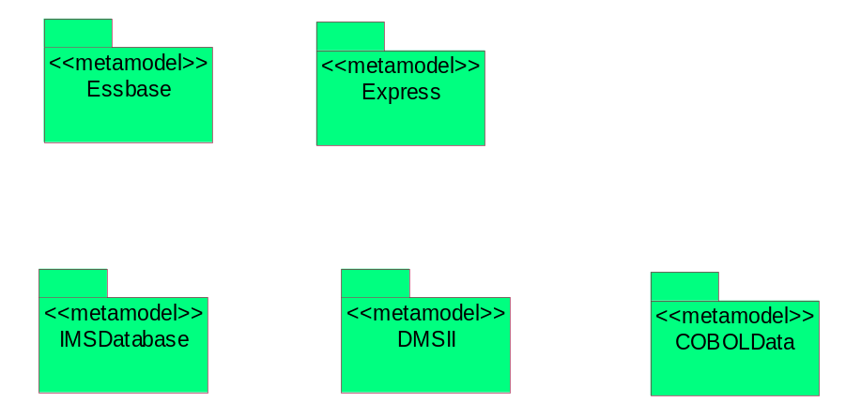
CWM 1.0 - Resources

Slide 78
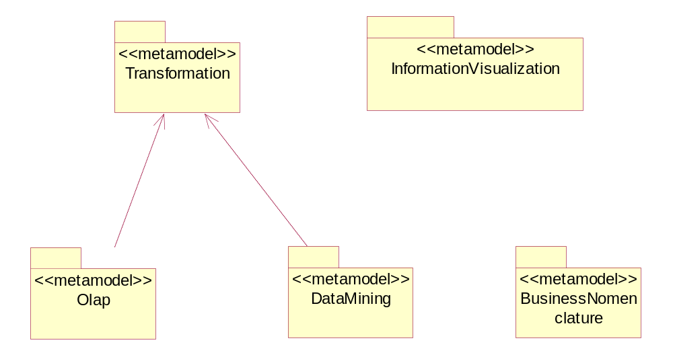
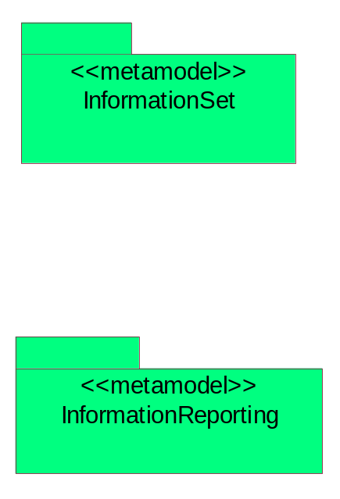
CWM 1.0 - Analysis

Slide 79
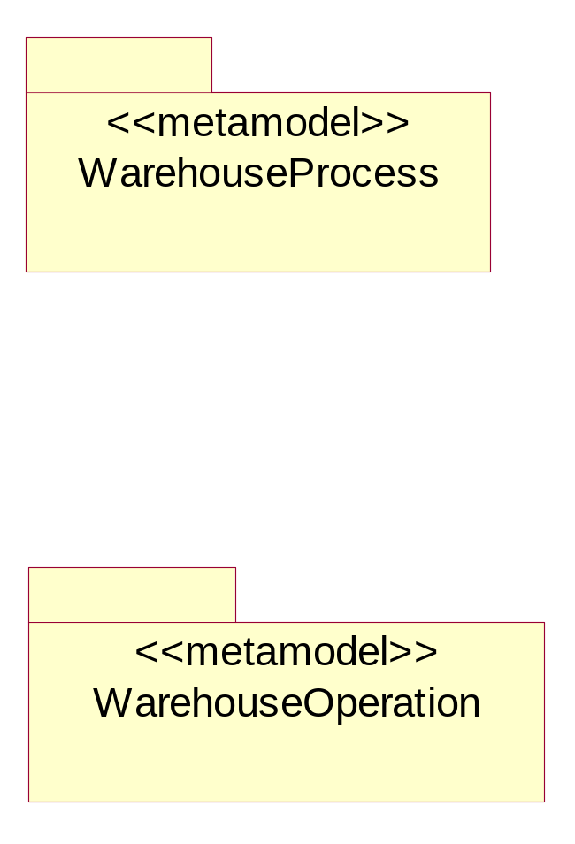
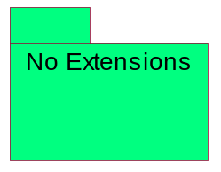
CWM 1.0 - Management

Slide 80
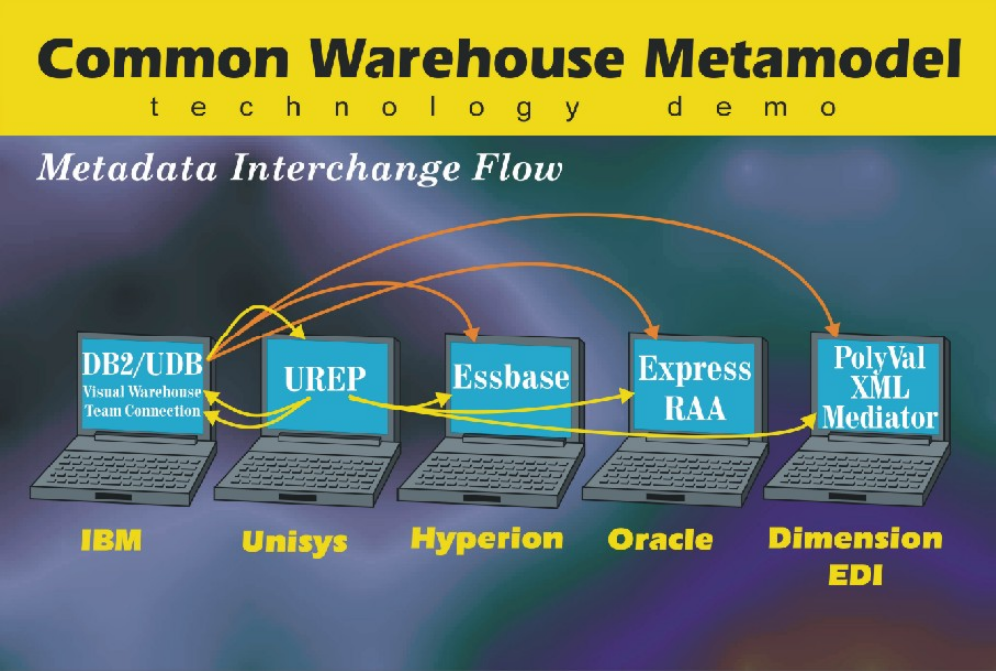
XMI/MOF for E-Business Intelligence November 1999 OMG Demo
Community & Enterprise Information Portals (KM…)
HealthCare
Financial
Manufacturing
Insurance...
E-Business
Application
Development
UML, CCM
E-Business
Intelligence
CWM, OIM
E-Business
Application
Integration
CCM, EJB,
COM+,XML
Information Models, Components
and Metadata (XMI, MOF…)
Directory, Security, Database,
Web, Transaction, Caching,
Metadata, Services..
Distributed Runtime Middleware (IIOP, HTTP…)

Slide 81
MOF/XMI for Application Integration and Industry Specific Domains
OMG XML/Value (2000)
UML Profile for EAI, I-EAI (2000)
Integration of OMG and OASIS Technologies/Frameworks
  XML/XMI Repository Discussions underway with ebXML
Knowledge Management (MDC and OMG efforts)
Utilities, Electronic Commerce (2000)
OMG Healthcare, Manufacturing, ECDTF…
Most EAI vendors using/planning XML for B2B
Community & Enterprise Information Portals (KM…)
HealthCare
Financial
Manufacturing
Insurance...
E-Business
Application
Development
UML, CCM
E-Business
Intelligence
CWM, OIM
E-Business
Application
Integration
CCM, EJB,
COM+,XML
Information Models, Components
and Metadata (XMI, MOF…)
Directory, Security, Database,
Web, Transaction, Caching,
Metadata, Services..
Distributed Runtime Middleware (IIOP, HTTP…)

Slide 82

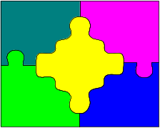


Travel Business Service Scenario
Customer
Repository
Customer
requests Itinerary
BXS Travel
interacts with multiple systems
responds with Itinerary
Customer
BXS Travel Service:
Make Travel
Arrangements
Flight
Reservation
Hotel
Reservation

Slide 83
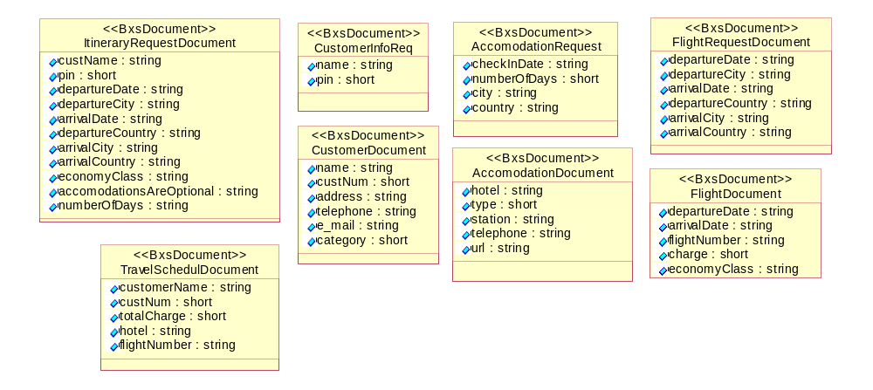
Fragments of the ‘Travel Business Model’

Slide 84
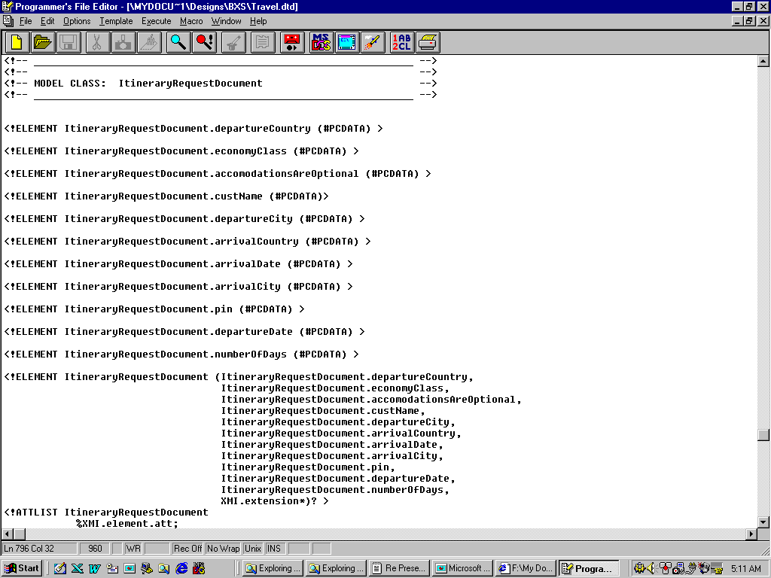
XMI: Travel DTD

Slide 85
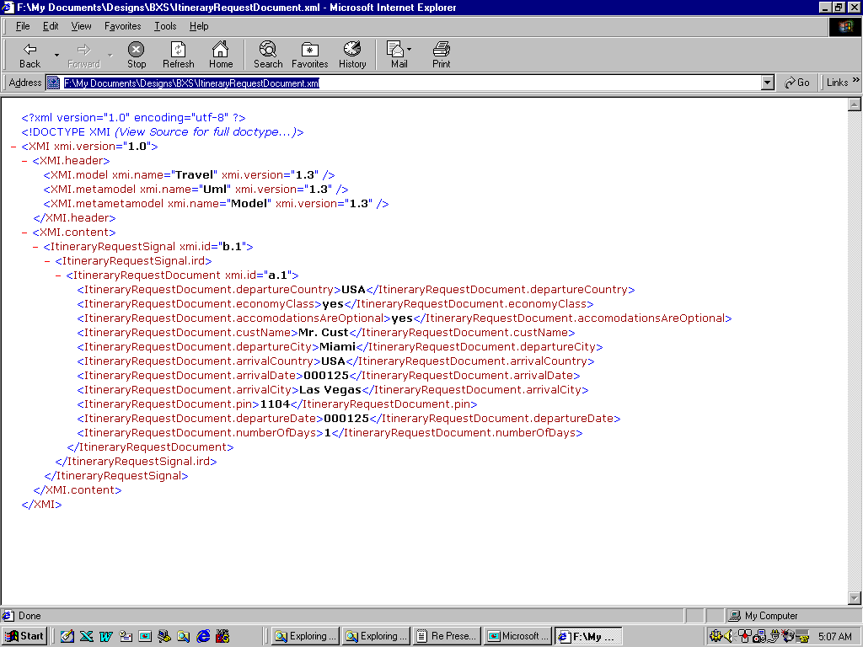
XMI Document for Travel DTD

Slide 86
MOF Compliant Metamodels
UML 1.3 (Physical)
MOF 1.3
CWM 1.0
IDL (CORBA 2.3)
CORBA/CCM
CIAS
Various emerging UML profiles
Vendor specific metamodels etc.

Slide 87
OMG Modeling and Metadata Framework
UML
Model & Design
XMI
MOF2XML DTD
MOF2XML Doc
MOF2XML Schema*
Vertical Industry
Specifications
Framework
Data Warehousing
MOF
Meta Manage
B2B Application
Integration
Model Driven
App Development
IDL
MOF2IDL
JMI*
MOF2Java
MetaData
Management
And So On
* Coming
JSR-40 JMI : Java Metadata Interface

Slide 88
Submissions
EDOC
EJB
Java
UML Profile
Evaluating
UML
XML
CORBA Med
MOF
Life Sciences
Utilities
EC
EC
EAI
IDL
EAI
CCM
CCM
CWM
CWM
UML
UML
Electronic
Commerce
MDC OIM
Enterprise
App Integration
Document
Management
Etc.
Standards
MOF
UML
CCM
IDL
CWM
An Integration and Interoperability Bus
for Objects, Components, Models, Metadata and Knowledge

Slide 89
Further Info
Web:
  OMG UML Resource Page
    www.omg.org/uml/
  UML Tutorial 4 will be posted next week
  www.unisys.com/marketplace/urep
  www.dstc.edu/au/mof
Email
  Sridhar Iyengar : sridhar.iyengar2@unisys.com
Conferences & workshops
  UML World 2000, NYC, March ‘00
  Java One, SFO, June ‘00
  UML ’00, York, England, Oct. ‘00
  Enterprise Repository 2000, England, Nov 00

